Slide 1
ANNUAL GENERAL MEETING OF SHAREHOLDERS
July 10, 2025

Slide 2
Disclaimer
The following presentation provides an analysis of the consolidated operating results and financial position of Velan Inc. (“the Company”) for fiscal 2025 ended February 28, 2025. This presentation should be read in conjunction with the Company’s audited consolidated financial statements for the fiscal years ended February 28, 2025, and February 29, 2024. The Company’s consolidated financial statements have been prepared in accordance with International Financial Reporting Standards as issued by the International Accounting Standards Board (“IFRS”). The significant accounting policies upon which these consolidated financial statements have been prepared are detailed in Note 2 of the Company’s audited consolidated financial statements. All foreign currency transactions, balances and overseas operations have been converted to U.S. dollars, the Company’s reporting currency. This presentation was reviewed by the Board of Directors of the Company on July 10, 2025. Additional information relating to the Company, including the Annual Information Form and Proxy Information Circular, can be found on SEDAR+ at www.sedarplus.ca.
NON-IFRS AND SUPPLEMENTARY FINANCIAL MEASURES
In this presentation, the Company has presented measures of performance or financial condition which are not defined under IFRS (“non-IFRS measures”) and are, therefore, unlikely to be comparable to similar measures presented by other companies. These measures are used by management in assessing the operating results and financial condition of the Company and are reconciled with the performance measures defined under IFRS. Reconciliations of these amounts can be found at the end of this presentation. The Company has also presented supplementary financial measures which are defined at the end of this presentation.
FORWARD-LOOKING INFORMATION
This presentation may include forward-looking statements, which generally contain words like “should”, “believe”, “anticipate”, “plan”, “may”, “will”, “expect”, “intend”, “continue” or “estimate” or the negatives of these terms or variations of them or similar expressions, all of which are subject to risks and uncertainties. These risks and uncertainties are disclosed in the Company’s filings with the appropriate securities commissions. While these statements are based on management’s assumptions regarding historical trends, current conditions and expected future developments, as well as other factors that it believes are reasonable and appropriate in the circumstances, no forward-looking statement can be guaranteed, and actual future results may differ materially from those expressed herein. The Company disclaims any intention or obligation to update or revise any forward-looking statements contained herein whether as a result of new information, future events or otherwise, except as required by the applicable securities laws. The forward-looking statements contained in this presentation are expressly qualified by this cautionary statement.

Slide 3
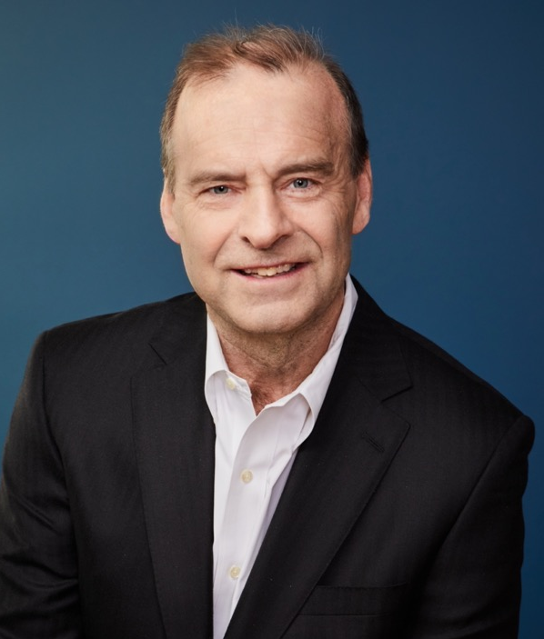
James A. Mannebach
Chairman of the Board and
Chief Executive Officer

Slide 4
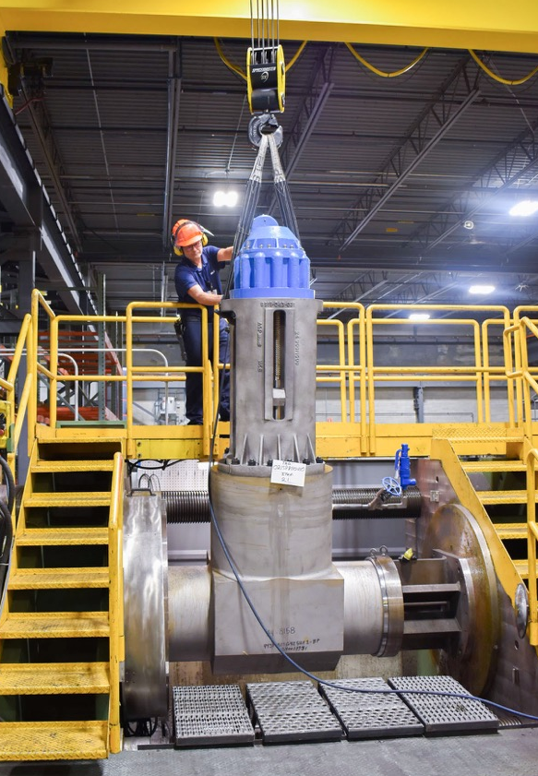
Fiscal 2025 Overview
Financial Highlights
  Sales from continuing operations reached $295.2M, up 14.1% year-over-year
  Gross margin improved by 770 basis points to 28.8%
  Adjusted EBITDA¹ from continuing operations totaled $27.5M compared to $2.1M in 2024
  Cash flow from operating activities amounted to $26.5M versus $12.5M in 2024
  Closed fiscal 2025 with backlog¹ of $274.9M
Operational Highlights
  Sold French subsidiaries, Velan France and Segault, for $208M, including $184M in cash
  Divested asbestos-related liabilities for $143M
  Net proceeds from transactions raised cash position to $55M on a pro forma basis
  Board of Directors approved special dividend of C$0.30 per share on top of regular dividend
¹ Non-IFRS measure – see Non-IFRS and Supplementary Financial Measures in the Appendix of this presentation.

Slide 5
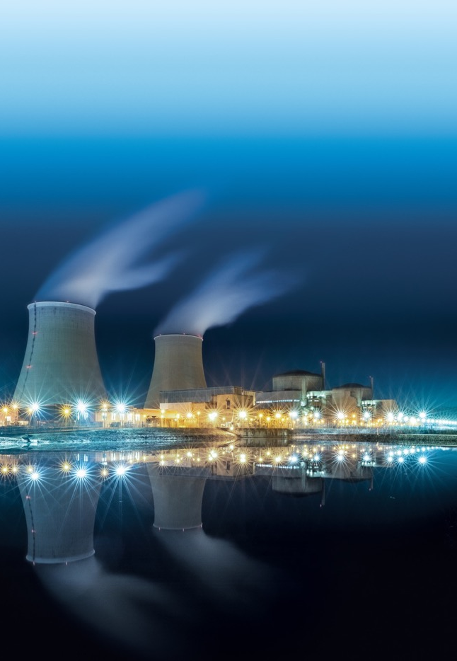
Key Growth Markets - Nuclear
Dynamic forces driving accelerated growth
Proliferation of data centres worldwide (AI)
Ambitious net-zero emissions objectives
Joint report by ITU and WBA¹: “Greening Digital Companies 2025”
Greenhouse gas emissions of top four digital giants increased 150% from 2020-2023
International Energy Agency forecasts global data centre electricity use will more than double to 945 TWh by 2030
Welcome news for nuclear industry and Velan
Nuclear energy considered viable alternative to fossil fuels
Electrification goals cannot be met without nuclear power
¹ International Telecom Union and World Benchmarking Alliance, respectively.

Slide 6
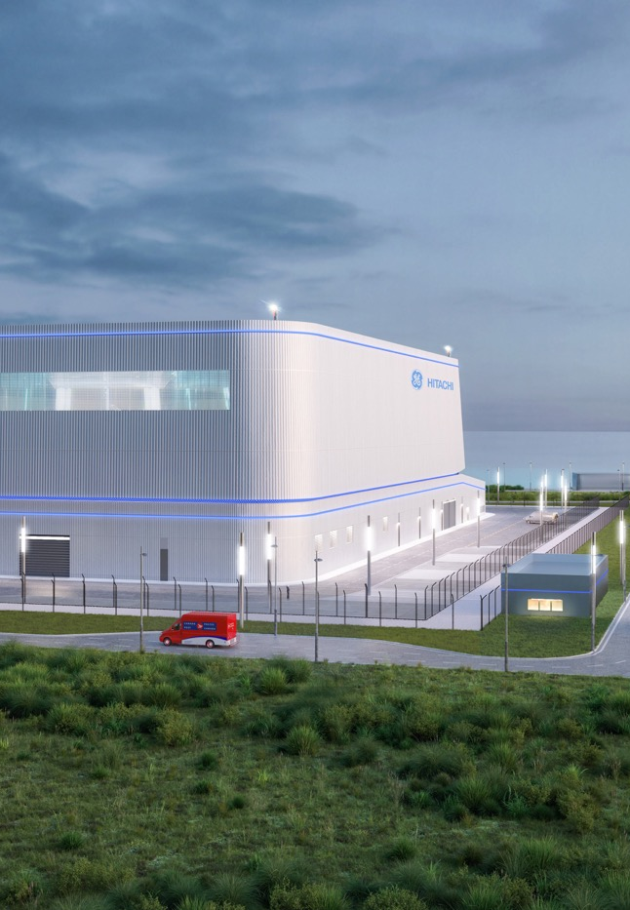
Key Growth Markets - Nuclear (continued)
Supplying valves to nuclear power customers for more than 55 years
Longstanding experience in most nuclear technologies
Market acceptance of SMRs triggered growth in demand for Velan’s proprietary valves
Partnering with leading industry players
Bruce Power, GE Hitachi, Westinghouse, Ontario Power Generation, AtkinsRéalis (CANDU)
Recurring revenues from large installed base
Life-extension projects
MRO activities
Anticipating acceleration in nuclear orders
Long-term projects may alter backlog profile

Slide 7
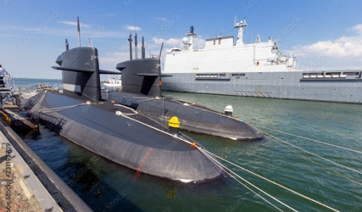
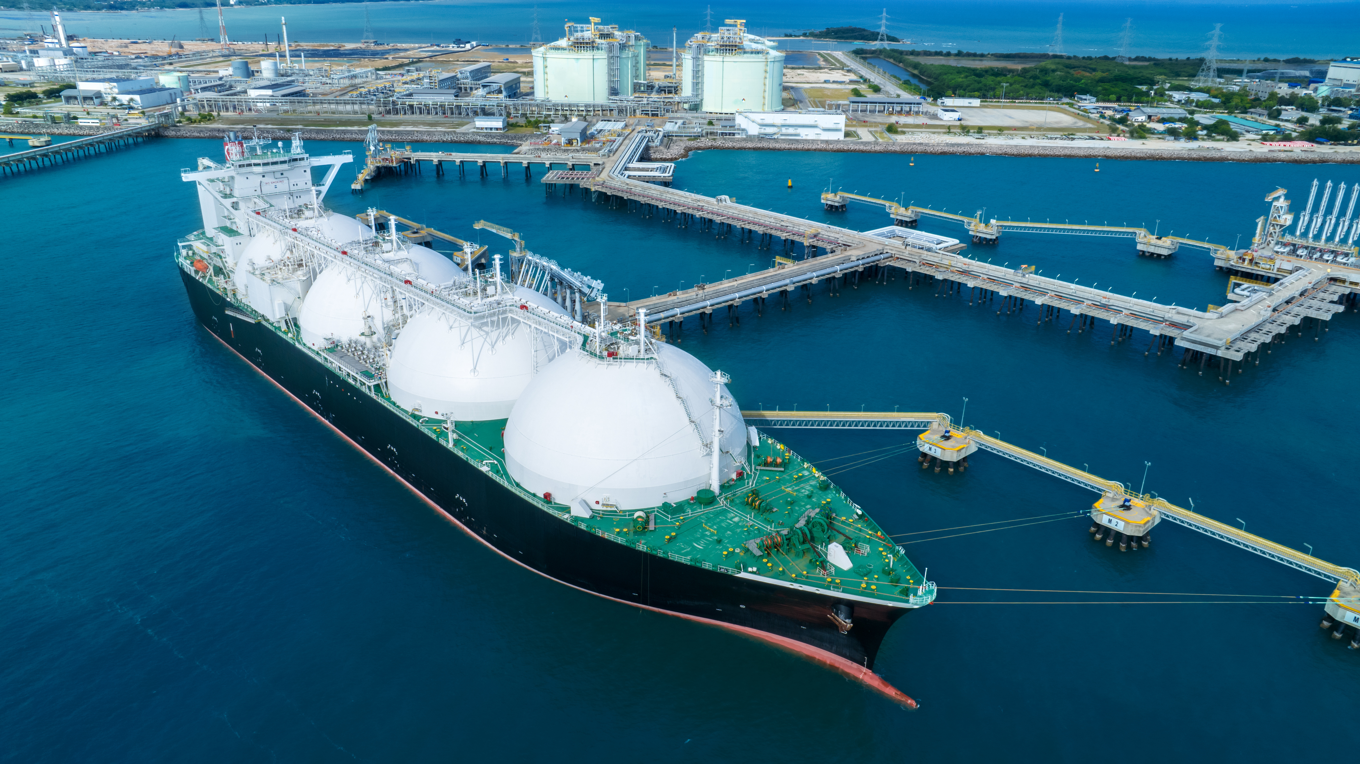

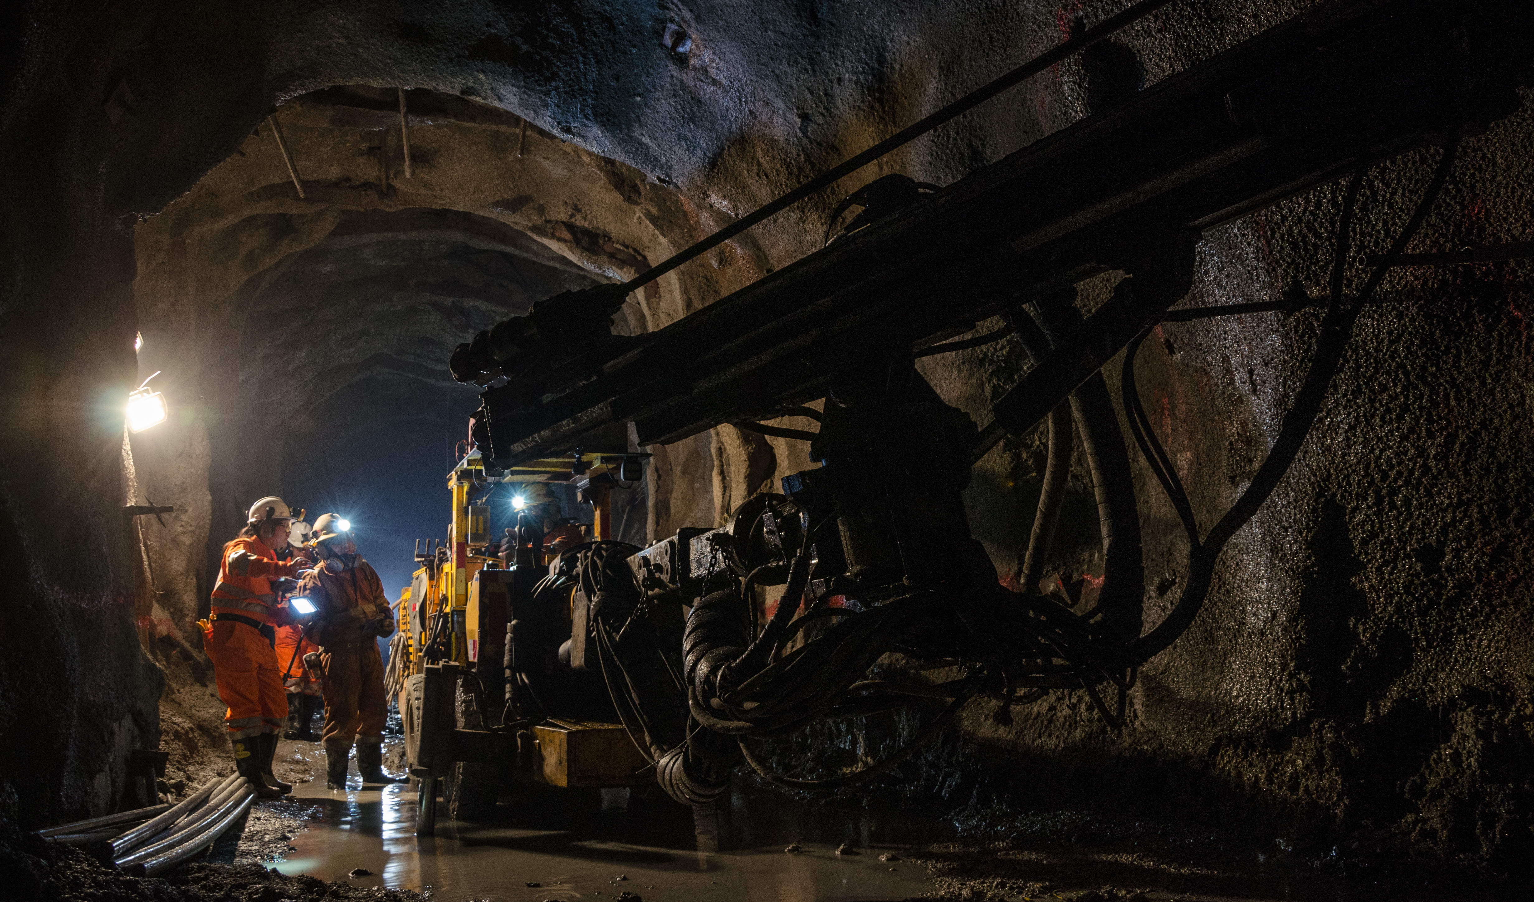
Key Growth Markets - Other Sectors
Customized solutions for critical industrial applications
DEFENSE
EXTREME TEMPERATURES
OIL & GAS
MINING
Heightened spending as governments address national security concerns
Deep knowledge of nuclear marine and aircraft propulsion technologies
Longstanding relationships with key market participants
Supplying most complete and advanced product line for LNG at extremely low temperatures
Extensive offering for hydrogen processes operating at very high temperatures
Growth driven by efforts to safeguard environment
High market penetration of N.A.’s oil refineries and growing presence overseas
Providing most reliable engineered valves and steam traps on the market
Established joint venture in Saudi Arabia to strengthen presence in the Middle East (largest market for oilfield valves)
Building strong presence in Southeast Asia, Australia and South America
Tremendous potential for titanium valves in highly corrosive environments

Slide 8
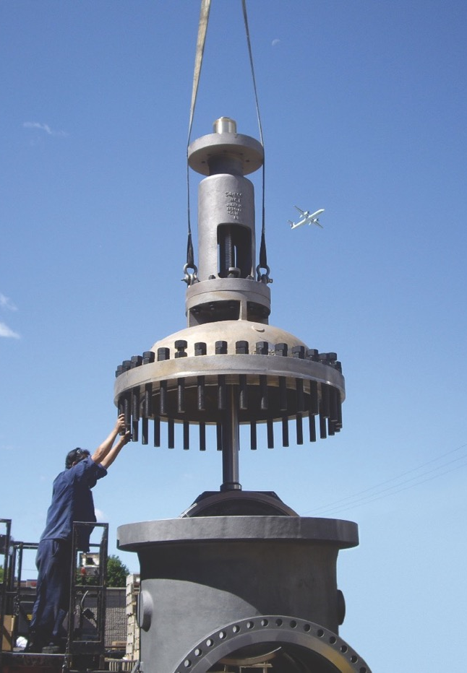
Uncertain Economic Environment
Trade disputes increasing level of uncertainty
Direct tariff effects
Retaliatory measures
Supply-chain disruptions
Executing plans to mitigate potential impact
Optimizing global production capabilities
Evaluating alternative sources for raw materials and components
Closely monitoring situation to best position the Company for the long term

Slide 9
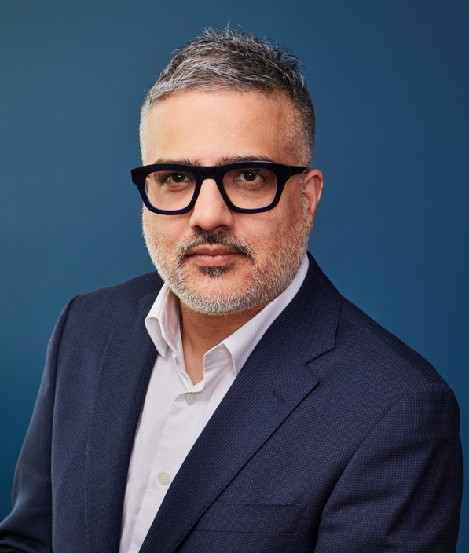
Rishi Sharma
Chief Financial Officer

Slide 10
Financial Overview¹
Annual Sales
($US Millions)
Sales
+14%
$36.5M vs Prior Year
  Higher shipments from Italian operations for oil & gas industry
  Greater volume from German business related to oil refineries
  Partially offset by slightly lower sales in N.A. and international markets, along with negative currency impact
FY-24
FY-25
¹ All financial metrics are from continuing operations.

Slide 11
Improved Margins
Annual Gross Profit
($US Millions)
Gross Profit
+55%
$30.3M vs Prior Year
  Higher business volume
  More favourable product mix
21.1%
28.8%
FY-24
FY-25

Slide 12
Growth in Profitability
Annual Profitability
($US Millions)
Adjusted EBITDA¹
$25.4M vs Prior Year
  Higher gross profit
  Partially offset by increased administration costs
Adjusted Net Income¹
$22.3M vs Prior Year
FY-24
FY-25
Adjusted EBITDA
Adjusted Net Income (loss)
¹ Non-IFRS measure – see Non-IFRS and Supplementary Financial Measures in the Appendix of this presentation.

Slide 13
Backlog¹ and Bookings¹
Backlog (in US$ millions)
$350
$300
$255
$260
$250
$215
$200
Backlog of $274.9M as at February 28, 2025
  Slight Y/Y increase, excluding negative FX impact of $12.7M
  Higher nuclear bookings in N.A., partially offset by lower oil & gas orders in Italy
Bookings of $292.5M in FY-25, up 1.3% from $288.7M in FY-24
Stronger nuclear and MRO orders in N.A.
Higher oil refinery bookings from German operations
Partially offset by less oil & gas orders from Italian business and negative FX impact
$150
$100
$50
$0
Q4-23
Q1-24
Q2-24
Q3-24
Q4-24
Q1-25
Q2-25
Q3-25
Q4-25
Backlog
< 12 months
Bookings and Sales (trailing 12-months, in US$ millions)
$350
$300
$250
$200
$150
$100
$50
$0
Q4-23
Q1-24
Q2-24
Q3-24
Q4-24
Q1-25
Q2-25
Q3-25
Q4-25
Bookings
Sales
Book-to-Bill (right axis)
¹ Non-IFRS measure – see Non-IFRS and Supplementary Financial Measures in the Appendix of this presentation.

Slide 14
Greater Cash Flow
Cash Flow from Operations
($US Millions)
Cash Flow from Operations
$14.0M vs Prior Year
  Increased adjusted EBITDA
  Improved working capital management
FY-24
FY-25
Financial Position (as at Feb. 28, 2025)
($US Millions)
Financial Position
  Cash position, net of bank indebtedness, totaled $32.4M at fiscal year-end
  Long-term debt amounted to $16.2M
  Pro forma cash position of $55M after asbestos-related transaction and sale of French assets
  New credit facilities of $35M available over 3 years
Cash and cash equivalents
Long-term debt
Bank
indebtedness

Slide 15
James A. Mannebach
Chairman of the Board and
Chief Executive Officer

Slide 16
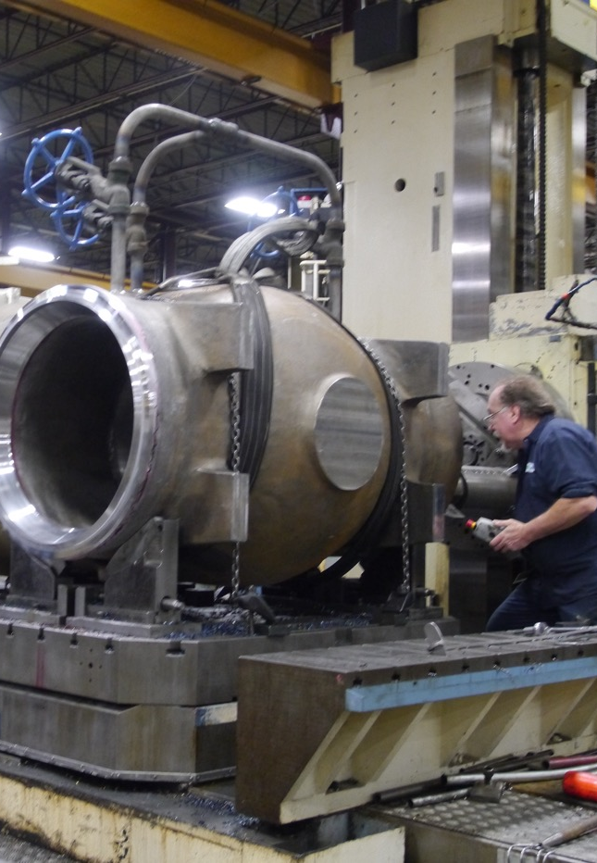
Wrap-Up
Delivered solid financial results in fiscal 2025
Improved execution and steady progress towards operational excellence
Looking to the future with a sharper focus
Driven by innovation and entrepreneurial spirit
Well-positioned to benefit from momentum in key markets
Supported by strong financial position to invest in our future
Leveraging strengths to maximize profitable growth and reward shareholders
Thanks to hard work and dedication by employees

Slide 17
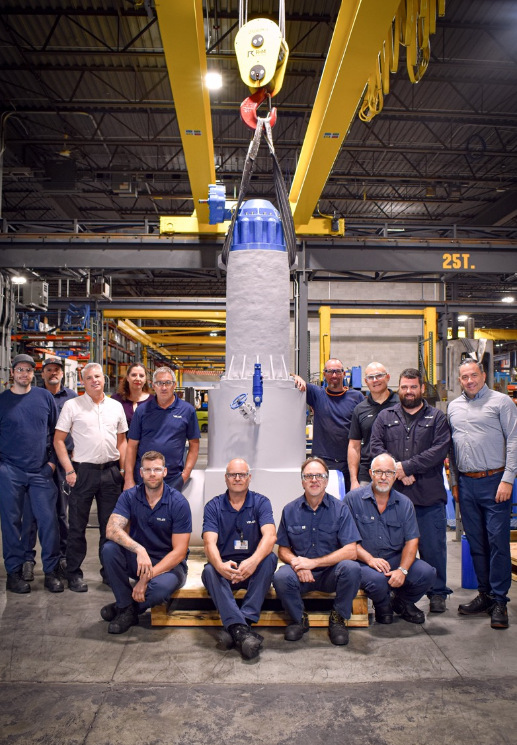
Appendix
Additional Information

Slide 18
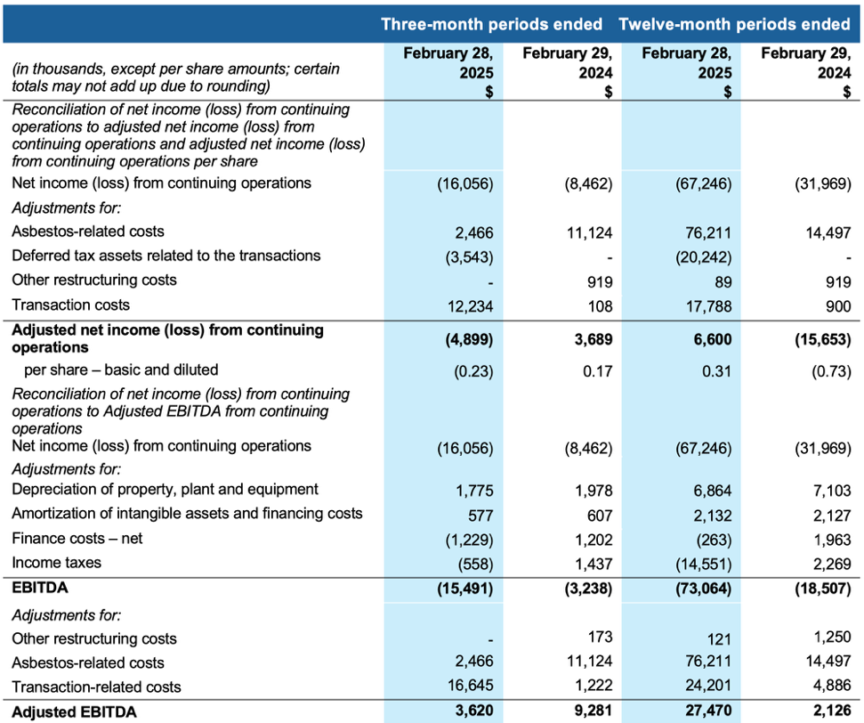
Non-IFRS and Supplementary Financial Measures
Non-IFRS measures
The term “Adjusted net income (loss)” is defined as net income or loss attributable to Subordinate and Multiple Voting Shares plus adjustment, net of income taxes, for costs related to restructuring and to the proposed transaction. The terms “Adjusted net income (loss) per share” is obtained by dividing Adjusted net income (loss) by the total amount of subordinate and multiple voting shares. The forward-looking statements contained in this MD&A are expressly qualified by this cautionary statement.
The term “EBITDA” is defined as adjusted net income plus depreciation of property, plant & equipment, plus amortization of intangible assets, plus net finance costs, plus income tax provision. The term “Adjusted EBITDA” is defined as EBITDA plus adjustment for costs related to restructuring and to the proposed transaction. The forward-looking statements contained in this document are expressly qualified by this cautionary statement.
Supplementary financial measures
The term “Net new orders” or “bookings” is defined as firm orders, net of cancellations, recorded by the Company during a period. Bookings are impacted by the fluctuation of foreign exchange rates for a given period. The measure provides an indication of the Company’s sales operation performance for a given period, as well as well as an expectation of future sales and cash flows to be achieved on these orders.
The term “backlog” is defined as the buildup of all outstanding bookings to be delivered by the Company. The Company’s backlog is impacted by the fluctuation of foreign exchange rates for a given period. The measure provides an indication of the future operational challenges of the Company as well as an expectation of future sales and cash flows to be achieved on these orders.
The term “book-to-bill ratio” is obtained by dividing bookings by sales. The measure provides an indication of the Company’s performance and outlook for a given period.

