Slide 1
Q1-FY2026
Investor Presentation
July 11, 2025

Slide 2
Disclaimer
The following presentation provides an analysis of the consolidated operating results and financial position of Velan Inc. (“the Company”) for the quarter ended May 31, 2025. This presentation should be read in conjunction with the Company’s audited consolidated financial statements for the fiscal years ended February 28, 2025, and February 29, 2024. The Company’s consolidated financial statements have been prepared in accordance with International Financial Reporting Standards as issued by the International Accounting Standards Board (“IFRS”). The significant accounting policies upon which these consolidated financial statements have been prepared are detailed in Note 2 of the Company’s audited consolidated financial statements. All foreign currency transactions, balances and overseas operations have been converted to U.S. dollars, the Company’s reporting currency. This presentation was reviewed by the Board of Directors of the Company on July 10, 2025. Additional information relating to the Company, including the Annual Information Form and Proxy Information Circular, can be found on SEDAR+ at www.sedarplus.ca.
NON-IFRS AND SUPPLEMENTARY FINANCIAL MEASURES
In this presentation, the Company has presented measures of performance or financial condition which are not defined under IFRS (“non-IFRS measures”) and are, therefore, unlikely to be comparable to similar measures presented by other companies. These measures are used by management in assessing the operating results and financial condition of the Company and are reconciled with the performance measures defined under IFRS. Reconciliations of these amounts can be found at the end of this presentation. The Company has also presented supplementary financial measures which are defined at the end of this presentation.
FORWARD-LOOKING INFORMATION
This presentation may include forward-looking statements, which generally contain words like “should”, “believe”, “anticipate”, “plan”, “may”, “will”, “expect”, “intend”, “continue” or “estimate” or the negatives of these terms or variations of them or similar expressions, all of which are subject to risks and uncertainties. These risks and uncertainties are disclosed in the Company’s filings with the appropriate securities commissions. While these statements are based on management’s assumptions regarding historical trends, current conditions and expected future developments, as well as other factors that it believes are reasonable and appropriate in the circumstances, no forward-looking statement can be guaranteed and actual future results may differ materially from those expressed herein. The Company disclaims any intention or obligation to update or revise any forward-looking statements contained herein whether as a result of new information, future events or otherwise, except as required by the applicable securities laws. The forward-looking statements contained in this presentation are expressly qualified by this cautionary statement.

Slide 3

James A. Mannebach
Chairman of the Board and
Chief Executive Officer

Slide 4
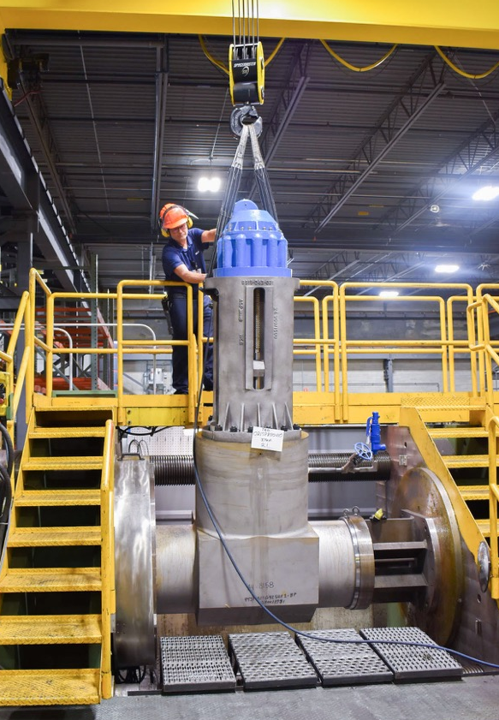
General Overview of the First Quarter
A solid performance
18.6% sales growth
100 bps gain in gross profit margin
Cash position in excess of $59M
Highest level in five years
Strong financial cushion will enable us to review our strategic options
Establish a balance between supporting long-term growth objectives and maximizing returns to shareholders
Board of Directors approved a change in our dividend policy
Significant increase in quarterly dividend to CA$0.10 per share
Reflects growing backlog and confidence in future financial performance and ability to sustain strong cash flow

Slide 5
Backlog¹ and Bookings¹
Backlog of $286.1M as at May 31, 2025
$241.3M deliverable within next 12 months
Increasing number of long-term contracts for the nuclear and defense sectors
Bookings of $78.2M in Q1-26, versus $83.0M in Q1-25
Lower year-over-year bookings in Germany and North America
  Large orders received last year
Higher bookings in China and Portugal
Higher maintenance, repair and overhaul (MRO) bookings
¹ Non-IFRS measure – see Non-IFRS and Supplementary Financial Measures in the Appendix of this presentation.

Slide 6
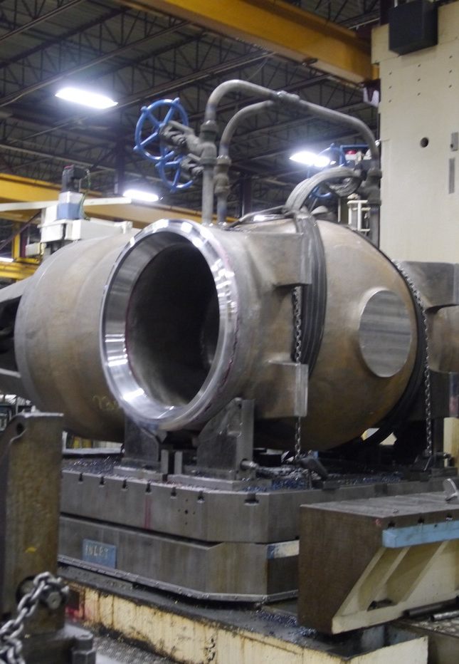
Growth Opportunities
Heightened traction in China
Traditional power consumption is booming
  Positive effect on our business
Most of our output in China is sold domestically
  Not meaningfully exposed to U.S. tariffs
Middle East is poised for solid growth
Largest market for oilfield valves
JV in Saudi Arabia to strengthen our presence
Achieved important qualification standards and awarded first significant production order

Slide 7
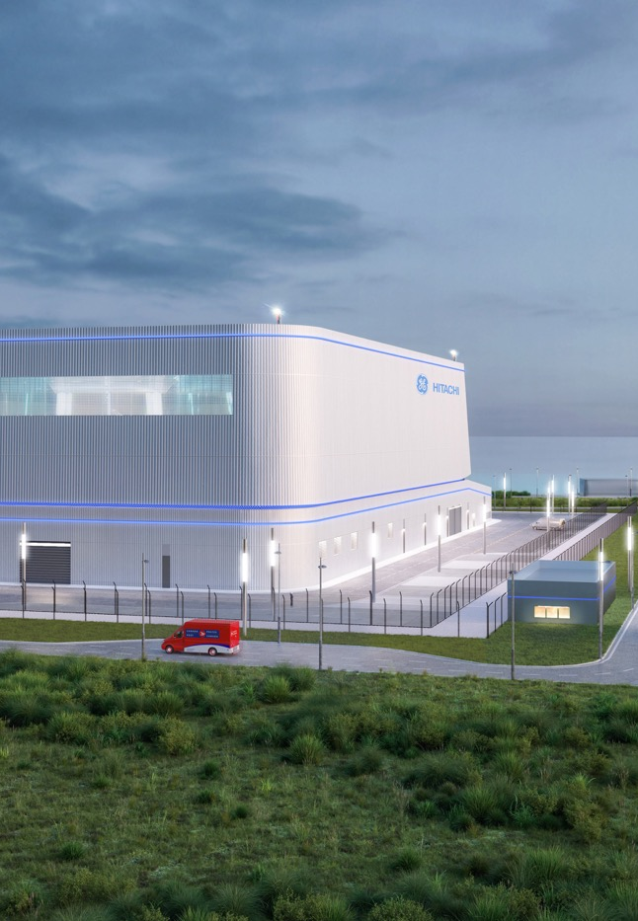
Growth Opportunities (continued)
Leveraging MRO opportunities
Vast installed base across several industrial markets
  Steady flow of orders quickly converted into sales
90% penetration rate at oil refineries in North America
  Significant repeat business reflected in our bookings
We remain bullish about the nuclear market
Work diligently with key players both for standard and small modular reactors (SMRs)
Revenue recognition cycle is longer term
  Expect announcements about expanded agreements in near future
Nuclear is increasingly relied upon as a viable alternative to fossil fuels

Slide 8
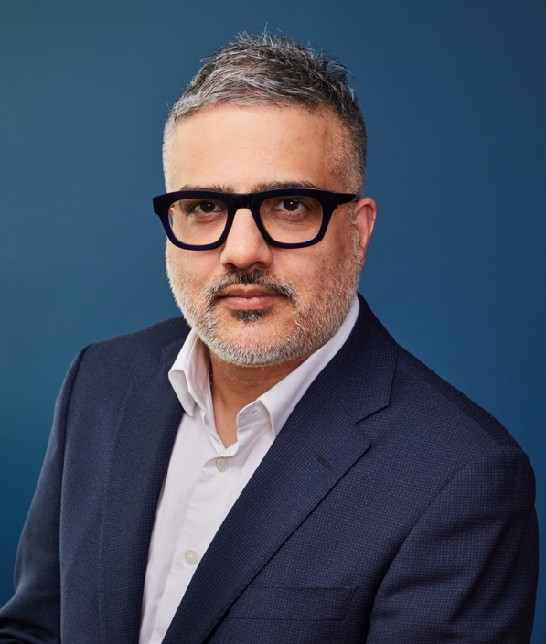
Rishi Sharma
Chief Financial and Administrative Officer

Slide 9
First-Quarter Results
Sales
$72.2M
14.1% vs. prior year
  Higher shipments from Italian, Chinese, Indian and German operations
  Partially offset by lower sales in other international markets
  Stable sales from North American operations
    Lower shipments to the defense industry offset by strong MRO activity

Slide 10
First-Quarter Results
Gross Profit
$20.6M
28.6% of sales
$3.8M vs. prior year
100 bps vs. prior year
27.6%
  Higher business volume
  More favourable product mix
  Lower material costs
  Lower provisions for aging inventory
Adjusted EBITDA¹
$4.0M
$1.2M vs. prior year
  Higher gross profit, partially offset by higher administration costs
  Excludes $5.7M in restructuring costs
¹ Non-IFRS measure – see Non-IFRS and Supplementary Financial Measures in the Appendix of this presentation.

Slide 11
First-Quarter Results
Cash Flow from Operating Activities
  Used $15.5M before net changes in provisions
  Includes transaction-related costs of $6.1M
  Negative changes in non-cash working capital this year versus last
    Lower short-term customer deposits this year
    Important inflow last year from collection of receivables
Financial Position
  Cash and cash equivalents of $59.1M at May 31, 2025
  Long-term debt, including current portion of $16.4M
  New credit facilities of $35M over three years
  Well positioned to further invest in operations and to consider strategic acquisitions
¹ Before net changes in provision.

Slide 12
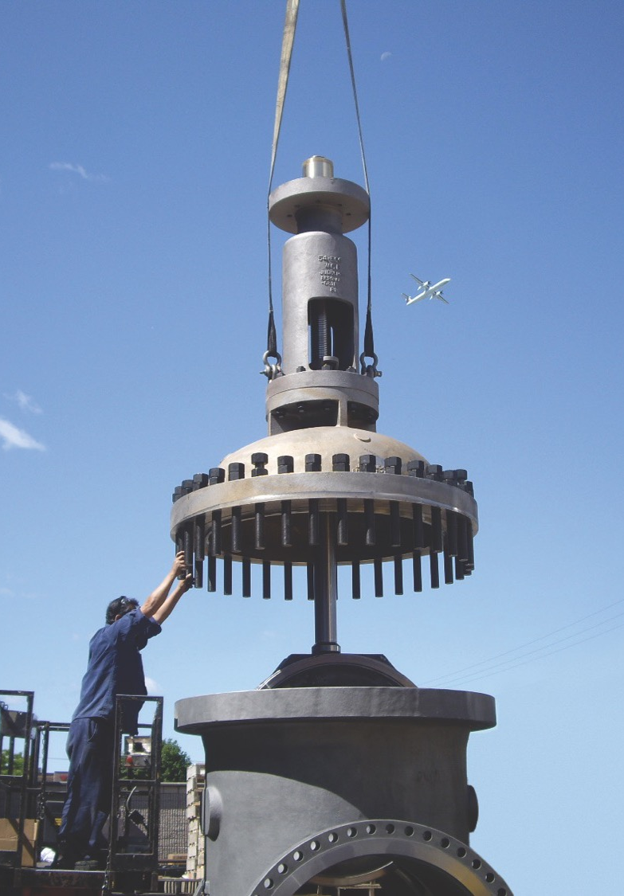





Thank you for attending our Q1-FY2026
Financial Results Investor Call.
We are happy to answer any questions.
velan.com
facebook.com/velan
@VelanInc
linkedin.com/VelanInc

Slide 13
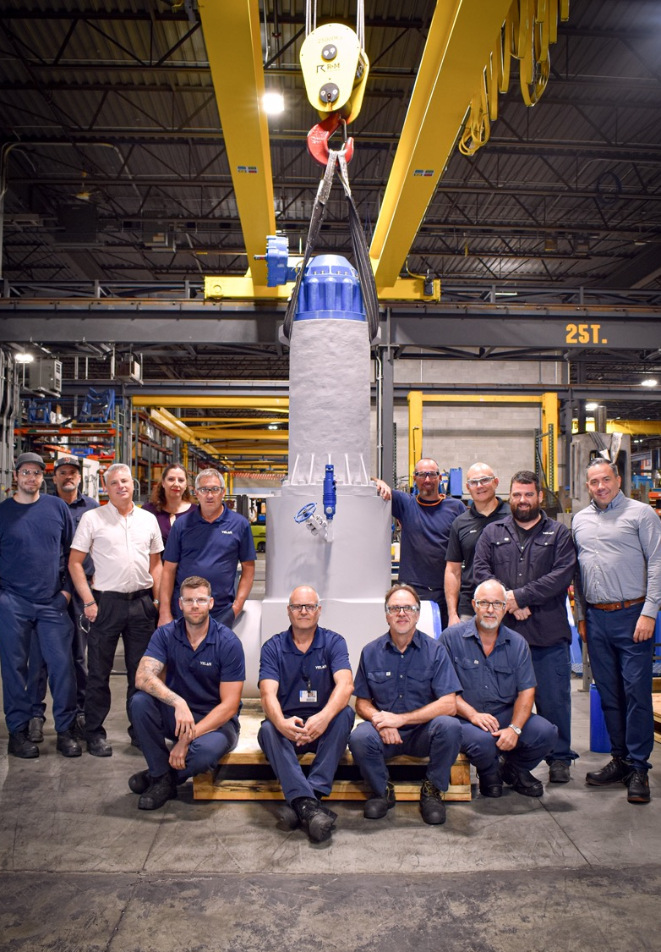
Appendix
Additional Information

Slide 14
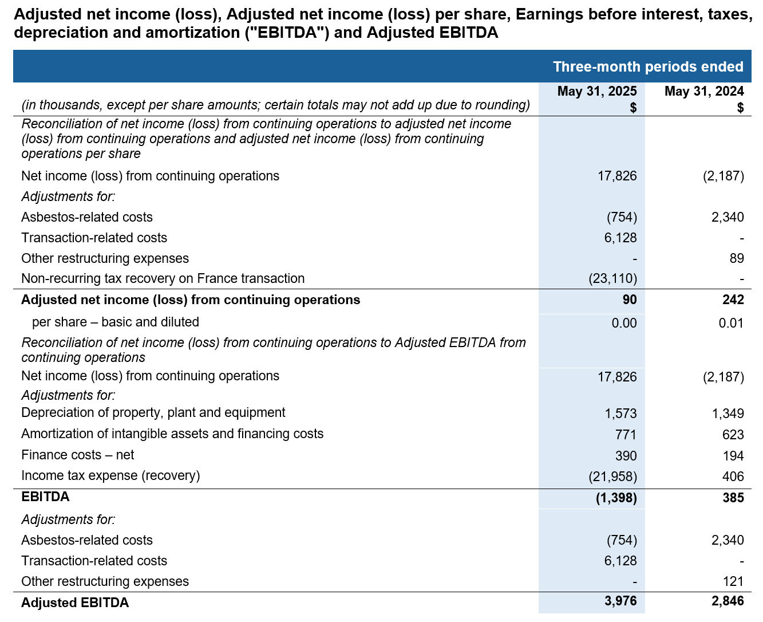
Non-IFRS and Supplementary Financial Measures
Non-IFRS measures
The term “Adjusted net income (loss)” is defined as net income or loss attributable to Subordinate and Multiple Voting Shares plus adjustment, net of income taxes, for costs related to restructuring and to the proposed transaction. The terms “Adjusted net income (loss) per share” is obtained by dividing Adjusted net income (loss) by the total amount of subordinate and multiple voting shares. The forward-looking statements contained in this MD&A are expressly qualified by this cautionary statement.
The term “EBITDA” is defined as adjusted net income plus depreciation of property, plant & equipment, plus amortization of intangible assets, plus net finance costs, plus income tax provision. The term “Adjusted EBITDA” is defined as EBITDA plus adjustment for costs related to restructuring and to the proposed transaction. The forward-looking statements contained in this document are expressly qualified by this cautionary statement.
Supplementary financial measures
The term “Net new orders” or “bookings” is defined as firm orders, net of cancellations, recorded by the Company during a period. Bookings are impacted by the fluctuation of foreign exchange rates for a given period. The measure provides an indication of the Company’s sales operation performance for a given period, as well as well as an expectation of future sales and cash flows to be achieved on these orders.
The term “backlog” is defined as the buildup of all outstanding bookings to be delivered by the Company. The Company’s backlog is impacted by the fluctuation of foreign exchange rates for a given period. The measure provides an indication of the future operational challenges of the Company as well as an expectation of future sales and cash flows to be achieved on these orders.
The term “book-to-bill ratio” is obtained by dividing bookings by sales. The measure provides an indication of the Company’s performance and outlook for a given period.

