Slide 1
Q2-FY2026 Investor Presentation
October 10, 2025

Slide 2
Disclaimer
The following presentation provides an analysis of the consolidated operating results and financial position of Velan Inc. (“the Company”) for the quarter ended August 31, 2025. This presentation should be read in conjunction with the Company’s audited consolidated financial statements for the fiscal years ended February 28, 2025, and February 29, 2024. The Company’s consolidated financial statements have been prepared in accordance with International Financial Reporting Standards as issued by the International Accounting Standards Board (“IFRS”). The significant accounting policies upon which these consolidated financial statements have been prepared are detailed in Note 2 of the Company’s audited consolidated financial statements. All foreign currency transactions, balances and overseas operations have been converted to U.S. dollars, the Company’s reporting currency. This presentation was reviewed by the Board of Directors of the Company on October 9, 2025. Additional information relating to the Company, including the Annual Information Form and Proxy Information Circular, can be found on SEDAR+ at www.sedarplus.ca.
NON-IFRS AND SUPPLEMENTARY FINANCIAL MEASURES
In this presentation, the Company has presented measures of performance or financial condition which are not defined under IFRS (“non-IFRS measures”) and are, therefore, unlikely to be comparable to similar measures presented by other companies. These measures are used by management in assessing the operating results and financial condition of the Company and are reconciled with the performance measures defined under IFRS. Reconciliations of these amounts can be found at the end of this presentation. The Company has also presented supplementary financial measures which are defined at the end of this presentation.
FORWARD-LOOKING INFORMATION
This presentation may include forward-looking statements, which generally contain words like “should”, “believe”, “anticipate”, “plan”, “may”, “will”, “expect”, “intend”, “continue” or “estimate” or the negatives of these terms or variations of them or similar expressions, all of which are subject to risks and uncertainties. These risks and uncertainties are disclosed in the Company’s filings with the appropriate securities commissions. While these statements are based on management’s assumptions regarding historical trends, current conditions and expected future developments, as well as other factors that it believes are reasonable and appropriate in the circumstances, no forward-looking statement can be guaranteed and actual future results may differ materially from those expressed herein. The Company disclaims any intention or obligation to update or revise any forward-looking statements contained herein whether as a result of new information, future events or otherwise, except as required by the applicable securities laws. The forward-looking statements contained in this presentation are expressly qualified by this cautionary statement.

Slide 3
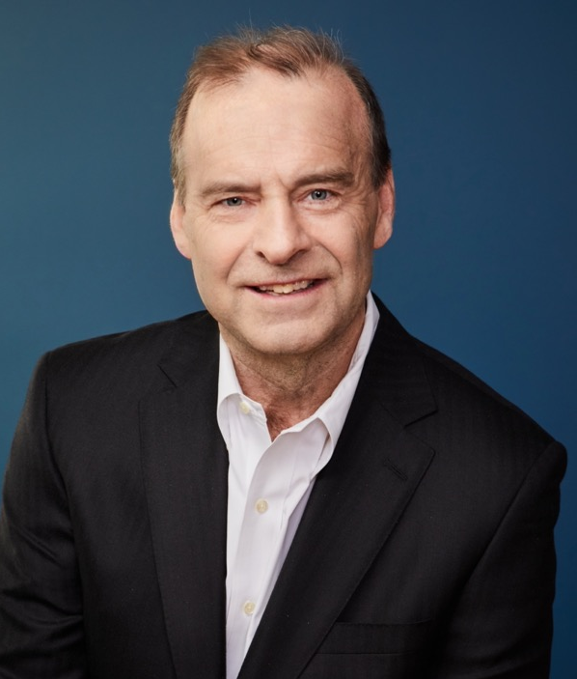
James A. Mannebach
Chairman of the Board and Chief Executive Officer

Slide 4
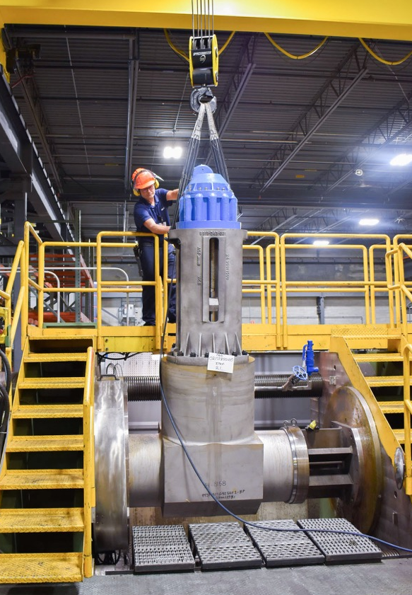
General Overview of Second Quarter
Sales of $67.6M and adjusted EBITDA¹ of $3.4M
Performance affected by the rescheduling of certain order deliveries to accommodate changes in customer requirements
Delays in purchasing decisions due to tariffs
Shipments totaling more than $12M rescheduled for second half
Shipped orders totaling approximately $5M early in Q3-26
Remainder planned for later in Q3 or before the end of the fiscal year
Promising pipeline through joint venture in Saudi Arabia
Shipped first order from new plant
Building on our momentum in the Middle East, the largest market worldwide for oilfield valves
Obtained prior approval and certification for key valves from Saudi Aramco
¹ Non-IFRS measure – see Non-IFRS and Supplementary Financial Measures in the Appendix of this presentation.

Slide 5
Backlog¹ and Bookings¹
Backlog of $285.8M as at August 31, 2025
Up 4.0% since the beginning of the fiscal year
$252.4M deliverable within next 12 months (88.3% of backlog)
Increase in long-term contracts from nuclear and defense sectors driving shift in delivery schedule
Bookings of $65.2M in Q2-26 compared to $88.4M in Q2-25
Lower bookings in North America and Germany
Large orders received in second quarter last year
Partially offset by increased orders from Italian operations
Rebound in order intake early in Q3
¹ Non-IFRS measure – see Non-IFRS and Supplementary Financial Measures in the Appendix of this presentation.

Slide 6
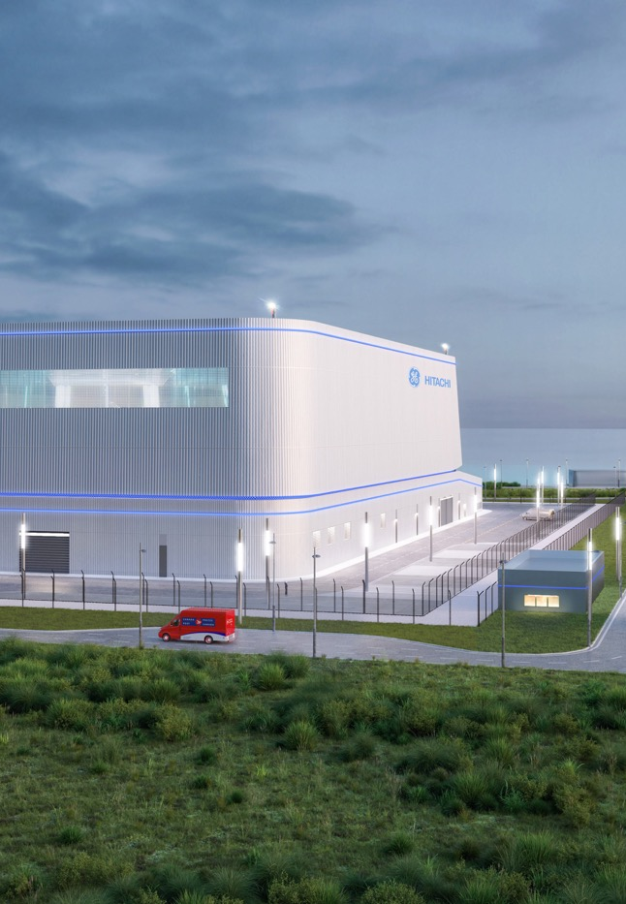
Fast-Tracked Infrastructure Projects
Role of Canada’s Major Projects Office (MPO)
Streamline regulatory assessment and approvals
Significantly reduce approval time for projects of national importance
Velan stands to benefit from accelerated projects
Darlington New Nuclear Project is being fast-tracked
Velan is a supplier of choice for GE Hitachi Nuclear Energy for this first small modular reactor (SMR) deployment in North America
We are providing the development of advanced technology, engineering support and leading-edge proprietary valves
Positions us as the leading valve provider in the growing SMR market

Slide 7
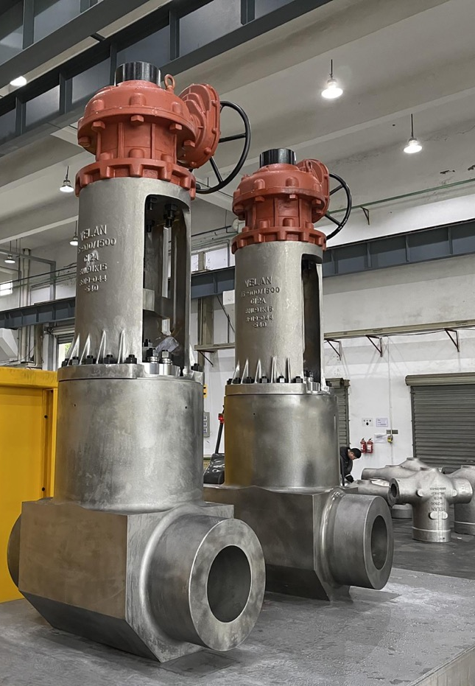
In Summary
Clean energy is a key growth sector for Velan worldwide
Customers move to reach their own carbon reduction objectives
Solid footing in other markets
Oil & Gas
Our valves equip the majority of refineries in North America
Growing worldwide base to further expand through Saudi Arabia JV
Defense activity on the rise
Deep knowledge of surface and sub-surface nuclear marine propulsion
Confident to sustain backlog growth
Strength of our brand
Proven ability to address complex needs for demanding applications

Slide 8
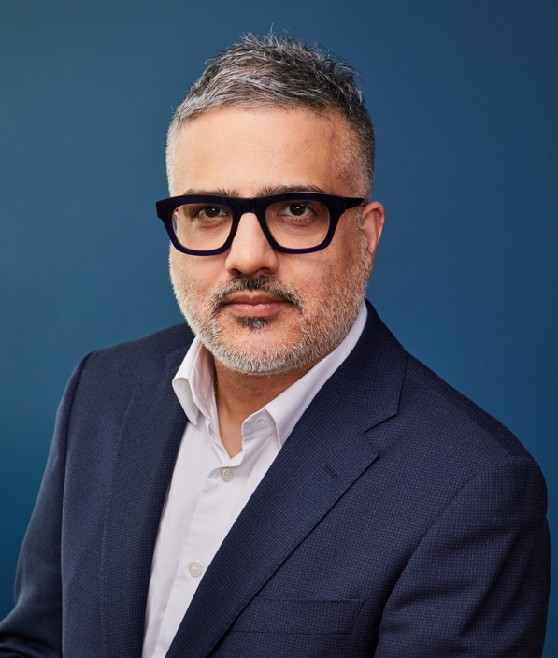
Rishi Sharma
Chief Financial and Administrative Officer

Slide 9
Second Quarter Results
Sales
$72.5*
$67.6M
13.0% vs. prior year
Excluding last year’s non-recurring revenue of $5.2M
$67.6M
6.7% vs. prior year
Lower sales from North American and Italian operations due to rescheduled shipments into second half of fiscal year
Tariff disruption
Partially offset by:
Higher sales in Korea, India and China
Greater MRO sales in North America
Positive FX impact
* Excluding non-recurring revenue.

Slide 10
Second Quarter Results
Gross Profit
$15.7M
23.2% of sales
$4.3M vs. prior year
250 bps vs. prior year
25.7%
Lower sales volume
Less favourable product mix
Tariff impact
Partially offset by positive FX impact
Adjusted EBITDA¹
$3.4M
$3.3M vs. prior year
Lower gross profit
Partially offset by reduced administration costs
¹ Non-IFRS measure – see Non-IFRS and Supplementary Financial Measures in the Appendix of this presentation.

Slide 11
Six-Month Results
$133.4*
Sales
$139.8M
0.9% vs. prior year
Excluding last year’s non-recurring revenue of $5.2M
$139.8M
4.8% vs. prior year
Gross Profit
$36.3M
26.0% of sales
$0.5M vs. prior year
50 bps vs. prior year
26.5%
* Excluding non-recurring revenue.

Slide 12
Cash Flow and Financial Position
Cash Flow from Operating Activities
Used $16.0M before net change in provisions
Reduced profitability
Negative changes in non-cash working capital, mainly due to work in process inventory related to changes in delivery schedule
Expected cash inflow as the situation normalizes
Solid Financial Position
Cash and cash equivalents of $36.1M
Long-term debt, including current portion, of $15.9M
Bank indebtedness of $6.6M
$96 million readily available to execute our strategy and finance our expansion
* Before net change in provisions.

Slide 13
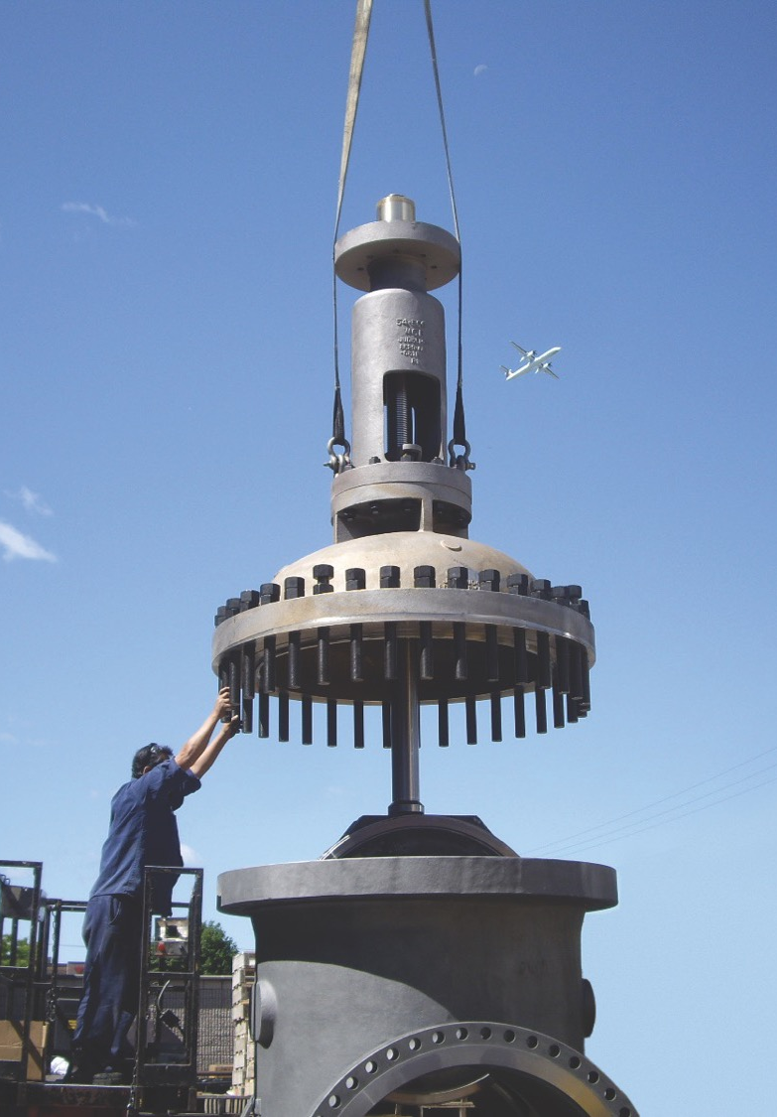





Thank you for attending our Q2-FY2026 Financial Results Investor Call.
We are happy to answer any questions.
velan.com
facebook.com/velan
@VelanInc
linkedin.com/VelanInc

Slide 14
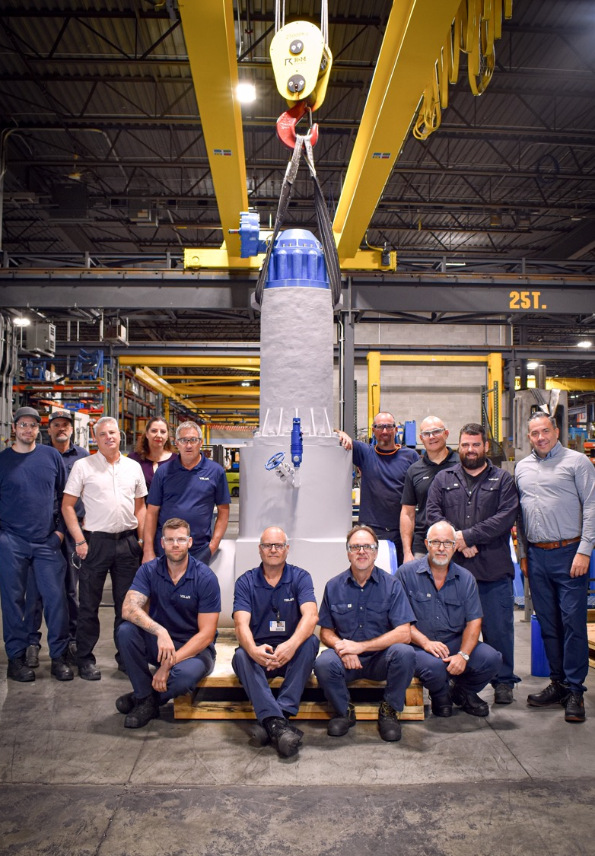
Appendix
Additional Information

Slide 15
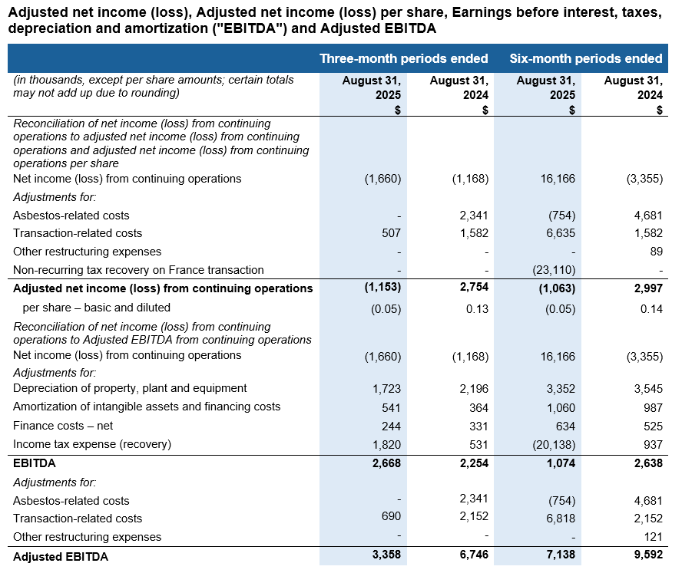
Non-IFRS and Supplementary Financial Measures
Non-IFRS measures
The term “Adjusted net income (loss)” is defined as net income or loss attributable to Subordinate and Multiple Voting Shares plus adjustment, net of income taxes, for costs related to restructuring and to the proposed transaction. The terms “Adjusted net income (loss) per share” is obtained by dividing Adjusted net income (loss) by the total amount of subordinate and multiple voting shares. The forward-looking statements contained in this MD&A are expressly qualified by this cautionary statement.
The term “EBITDA” is defined as adjusted net income plus depreciation of property, plant & equipment, plus amortization of intangible assets, plus net finance costs, plus income tax provision. The term “Adjusted EBITDA” is defined as EBITDA plus adjustment for costs related to restructuring and to the proposed transaction. The forward-looking statements contained in this document are expressly qualified by this cautionary statement.
Supplementary financial measures
The term “Net new orders” or “bookings” is defined as firm orders, net of cancellations, recorded by the Company during a period. Bookings are impacted by the fluctuation of foreign exchange rates for a given period. The measure provides an indication of the Company’s sales operation performance for a given period, as well as well as an expectation of future sales and cash flows to be achieved on these orders.
The term “backlog” is defined as the buildup of all outstanding bookings to be delivered by the Company. The Company’s backlog is impacted by the fluctuation of foreign exchange rates for a given period. The measure provides an indication of the future operational challenges of the Company as well as an expectation of future sales and cash flows to be achieved on these orders.
The term “book-to-bill ratio” is obtained by dividing bookings by sales. The measure provides an indication of the Company’s performance and outlook for a given period.

